Slide 1
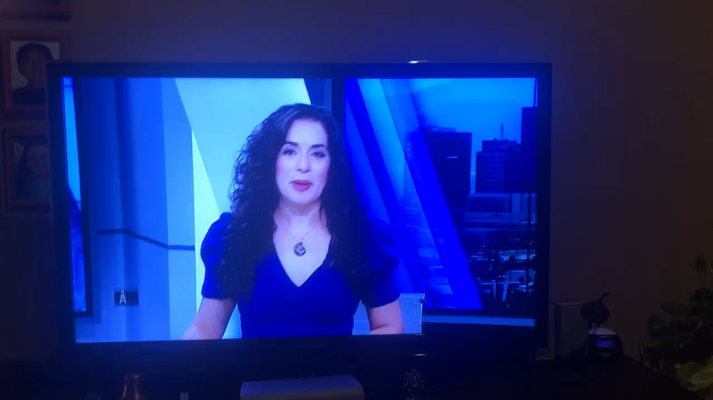

Ellas-100th-on-channel-7.mp4 can't be downloaded securely
Click on picture, then click arrow Below the frame

Slide 2
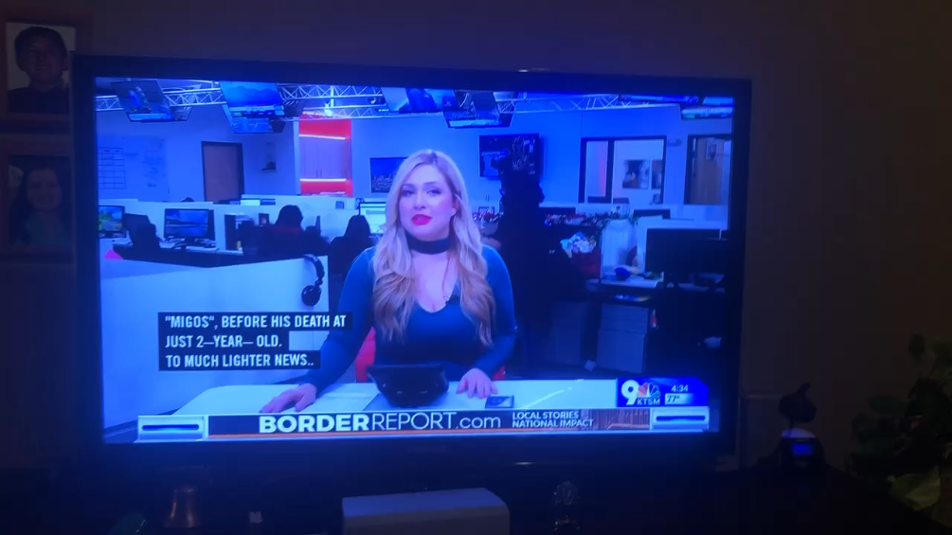
http://elpasobridge.com/wp-content/uploads/2012/04/Ellas-100th-on-channel-9.mp4

