Slide 1


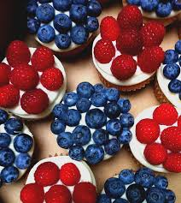

Slide 2
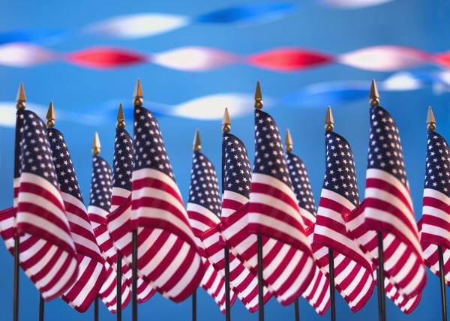
Jerald Gershowitz – 1
Gustavo Gonzalez - 3
Kay White – 9
Sharon Butterworth – 13
Billy Crews – 14
Pat Lama – 20
Paul Ritters – 21
Edgar Flores – 22
Phyllis Saltzstein – 22
Sara Blaugrund – 24
Laura Jacobs – 27
July Birthdays
1 - Jerald Gershowitz 1 - Gordon Mahon 9 - Kay White 13 - Sharon Butterworth 13 - James Stewart | 14 - Billy Crews 20 - Pat Lama 21 - Paul Ritters 22 - Edgar Flores

Slide 3



July 4th

Slide 4

Go to www.acbl.org for reservation information at the FOUR Minneapolis Host Hotels
North American Bridge Championships
Gustavo Gonzalez is looking for a partner for this tournament
July 9th through July 19th
AKA Summer Nationals

Slide 5
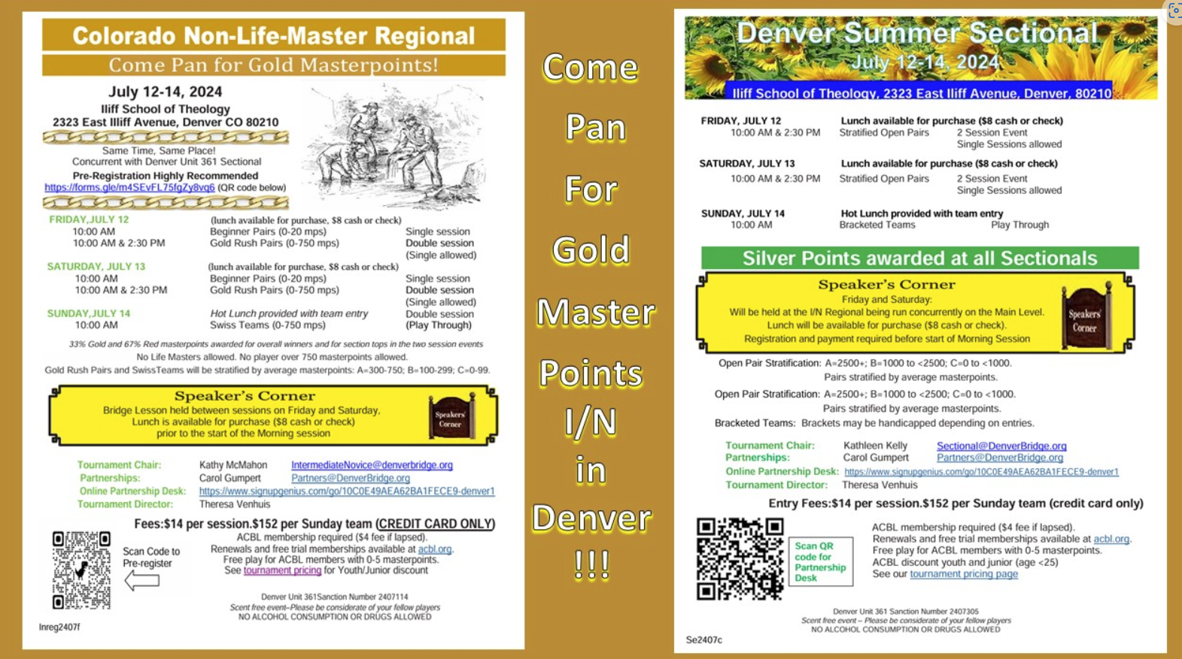

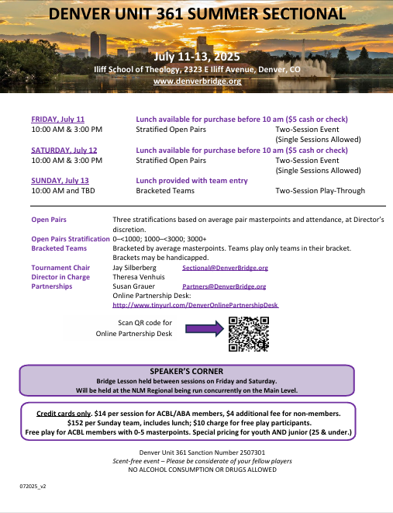
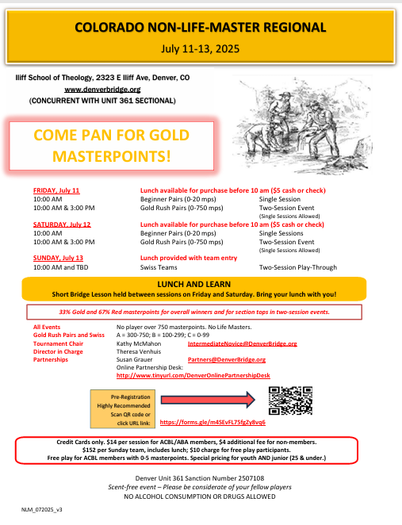
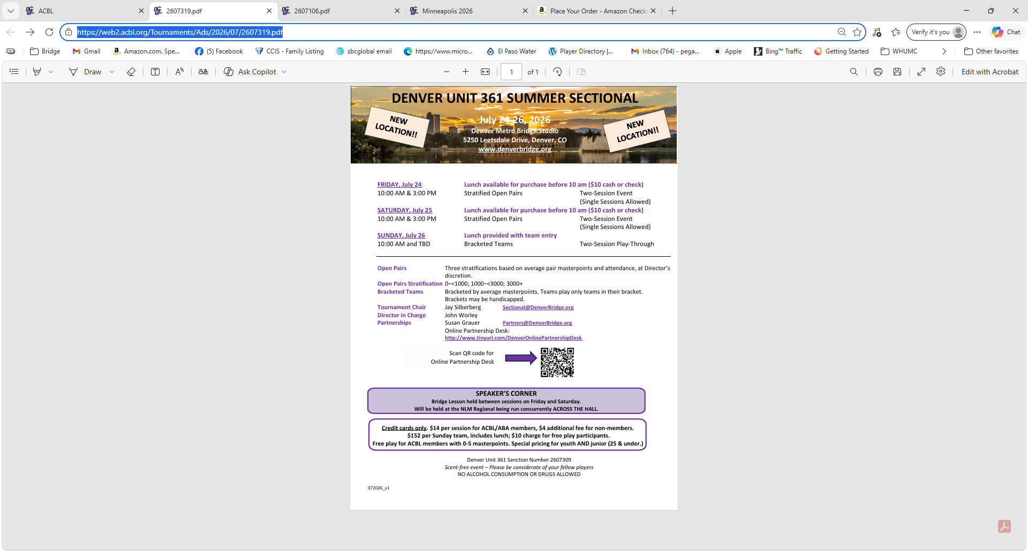
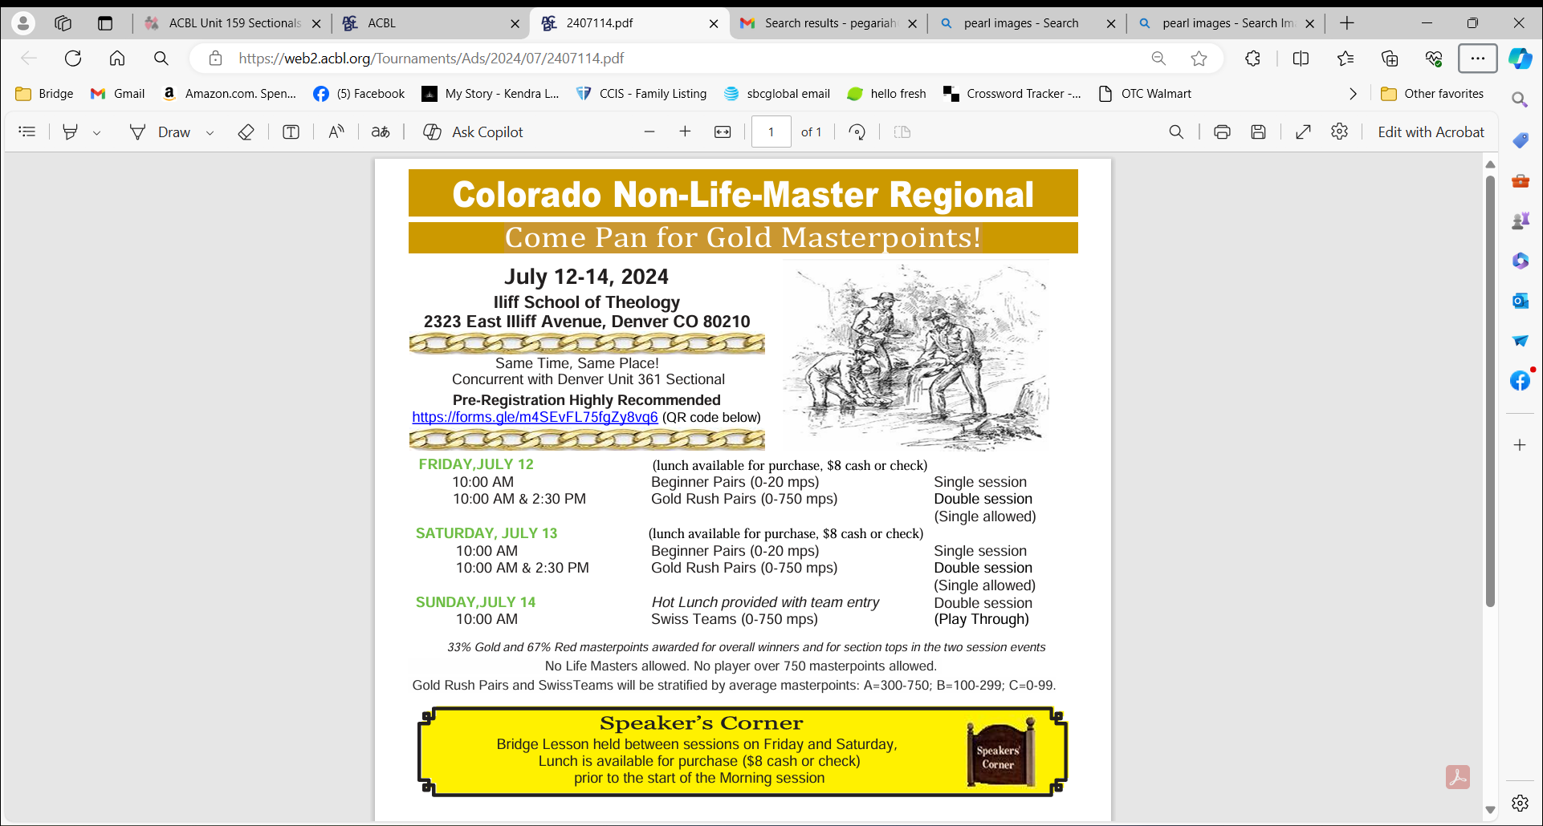
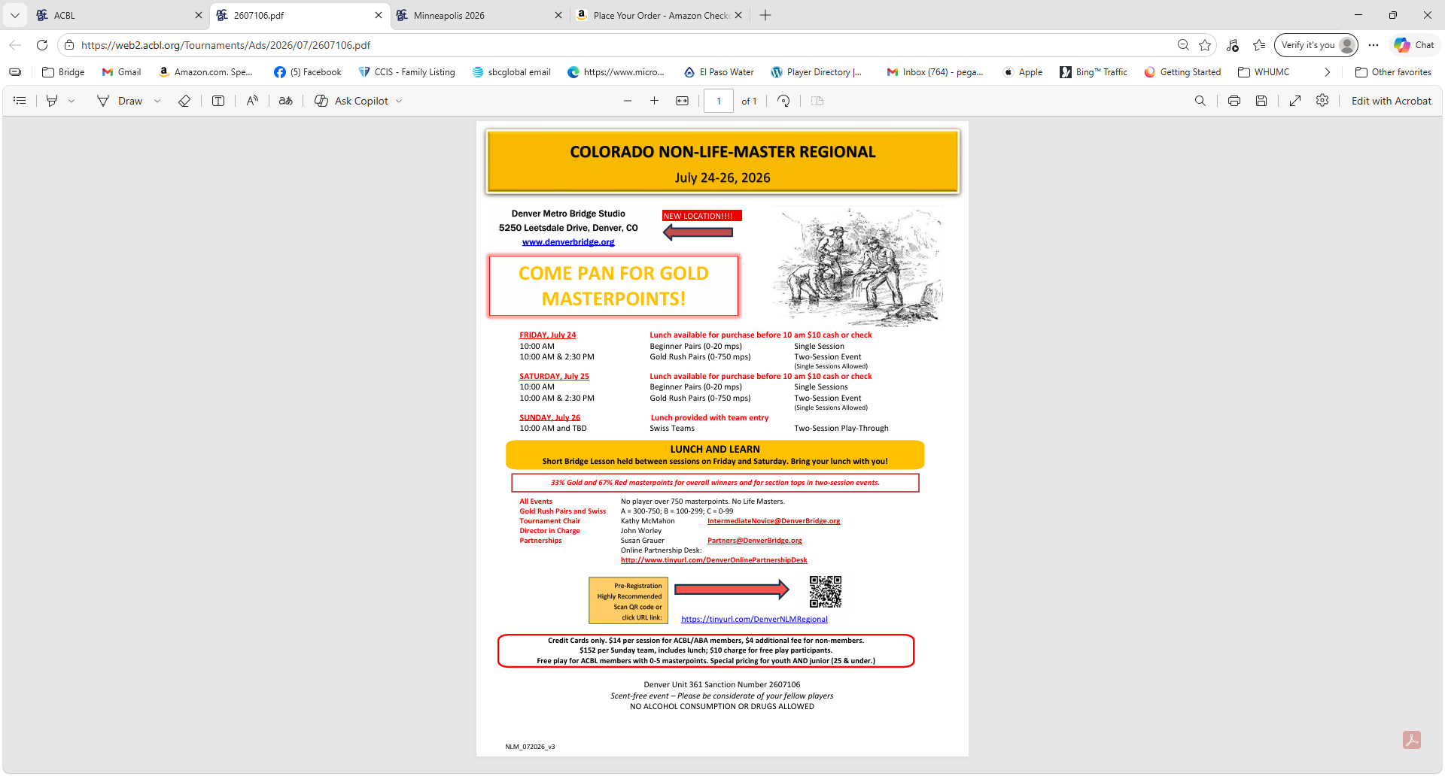
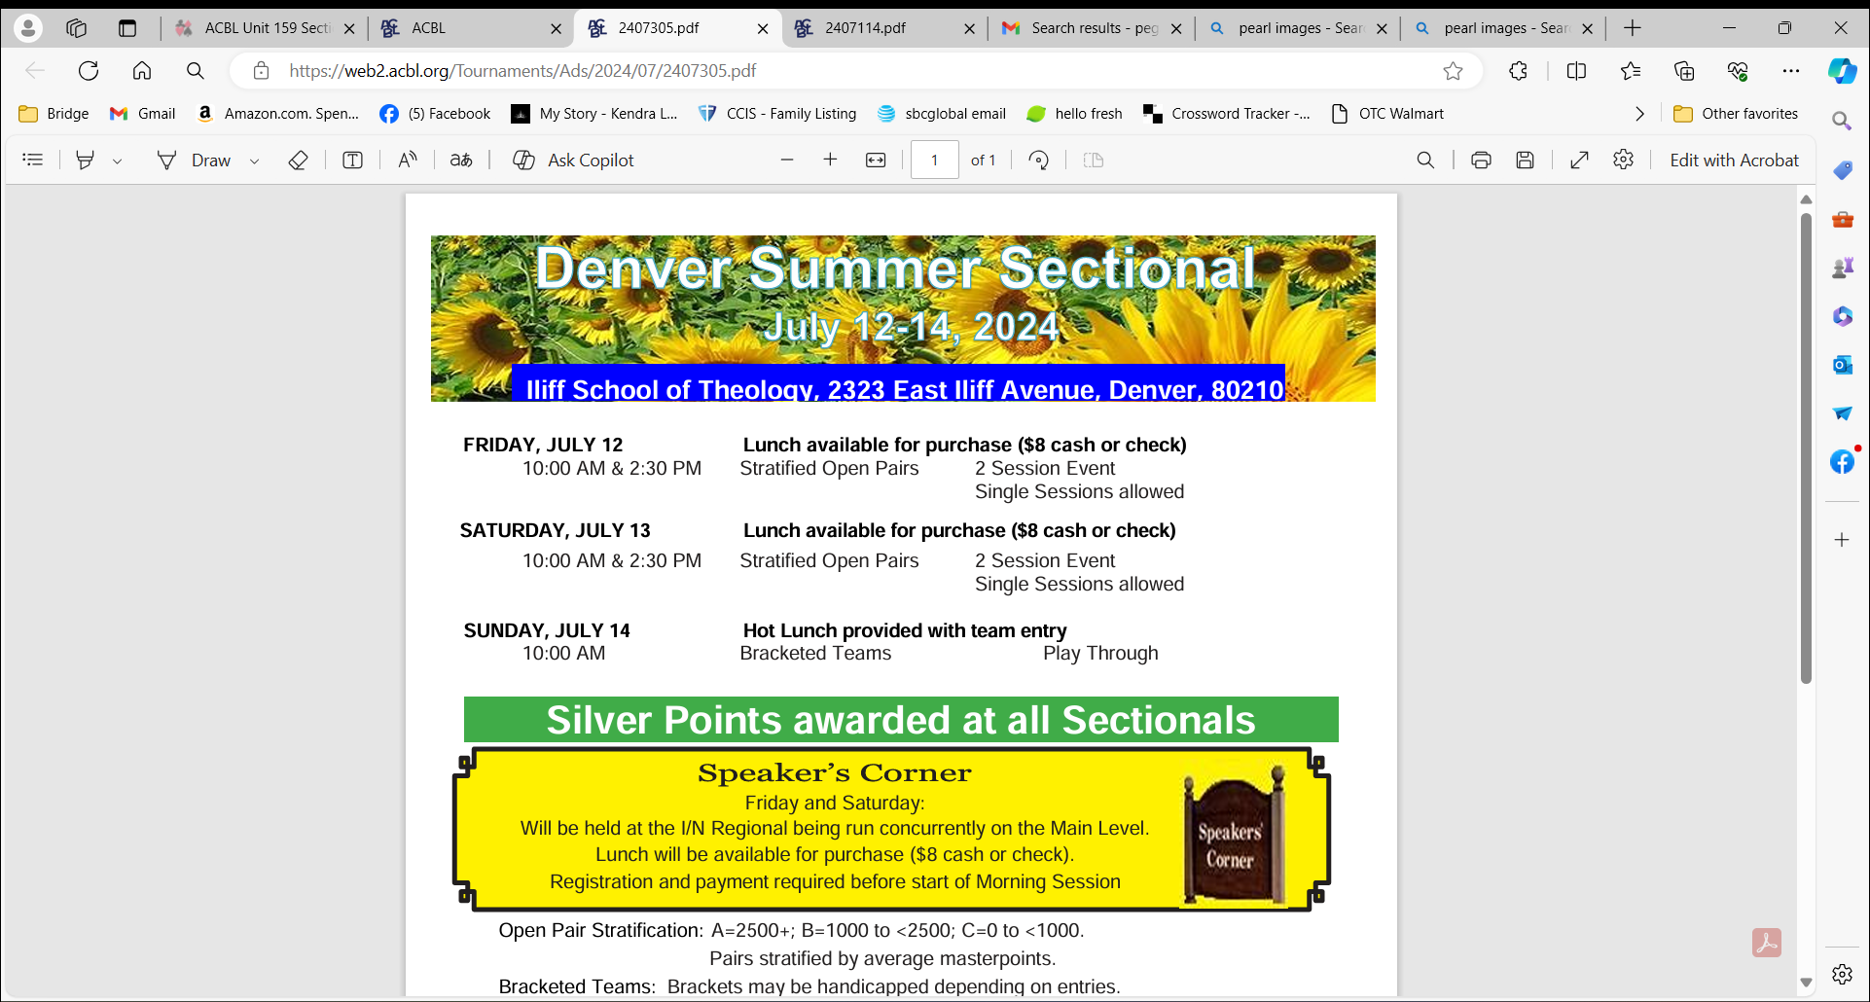
Come
Pan
For
Gold
Master
Points
I/N
in
Denver
!!!

Slide 6
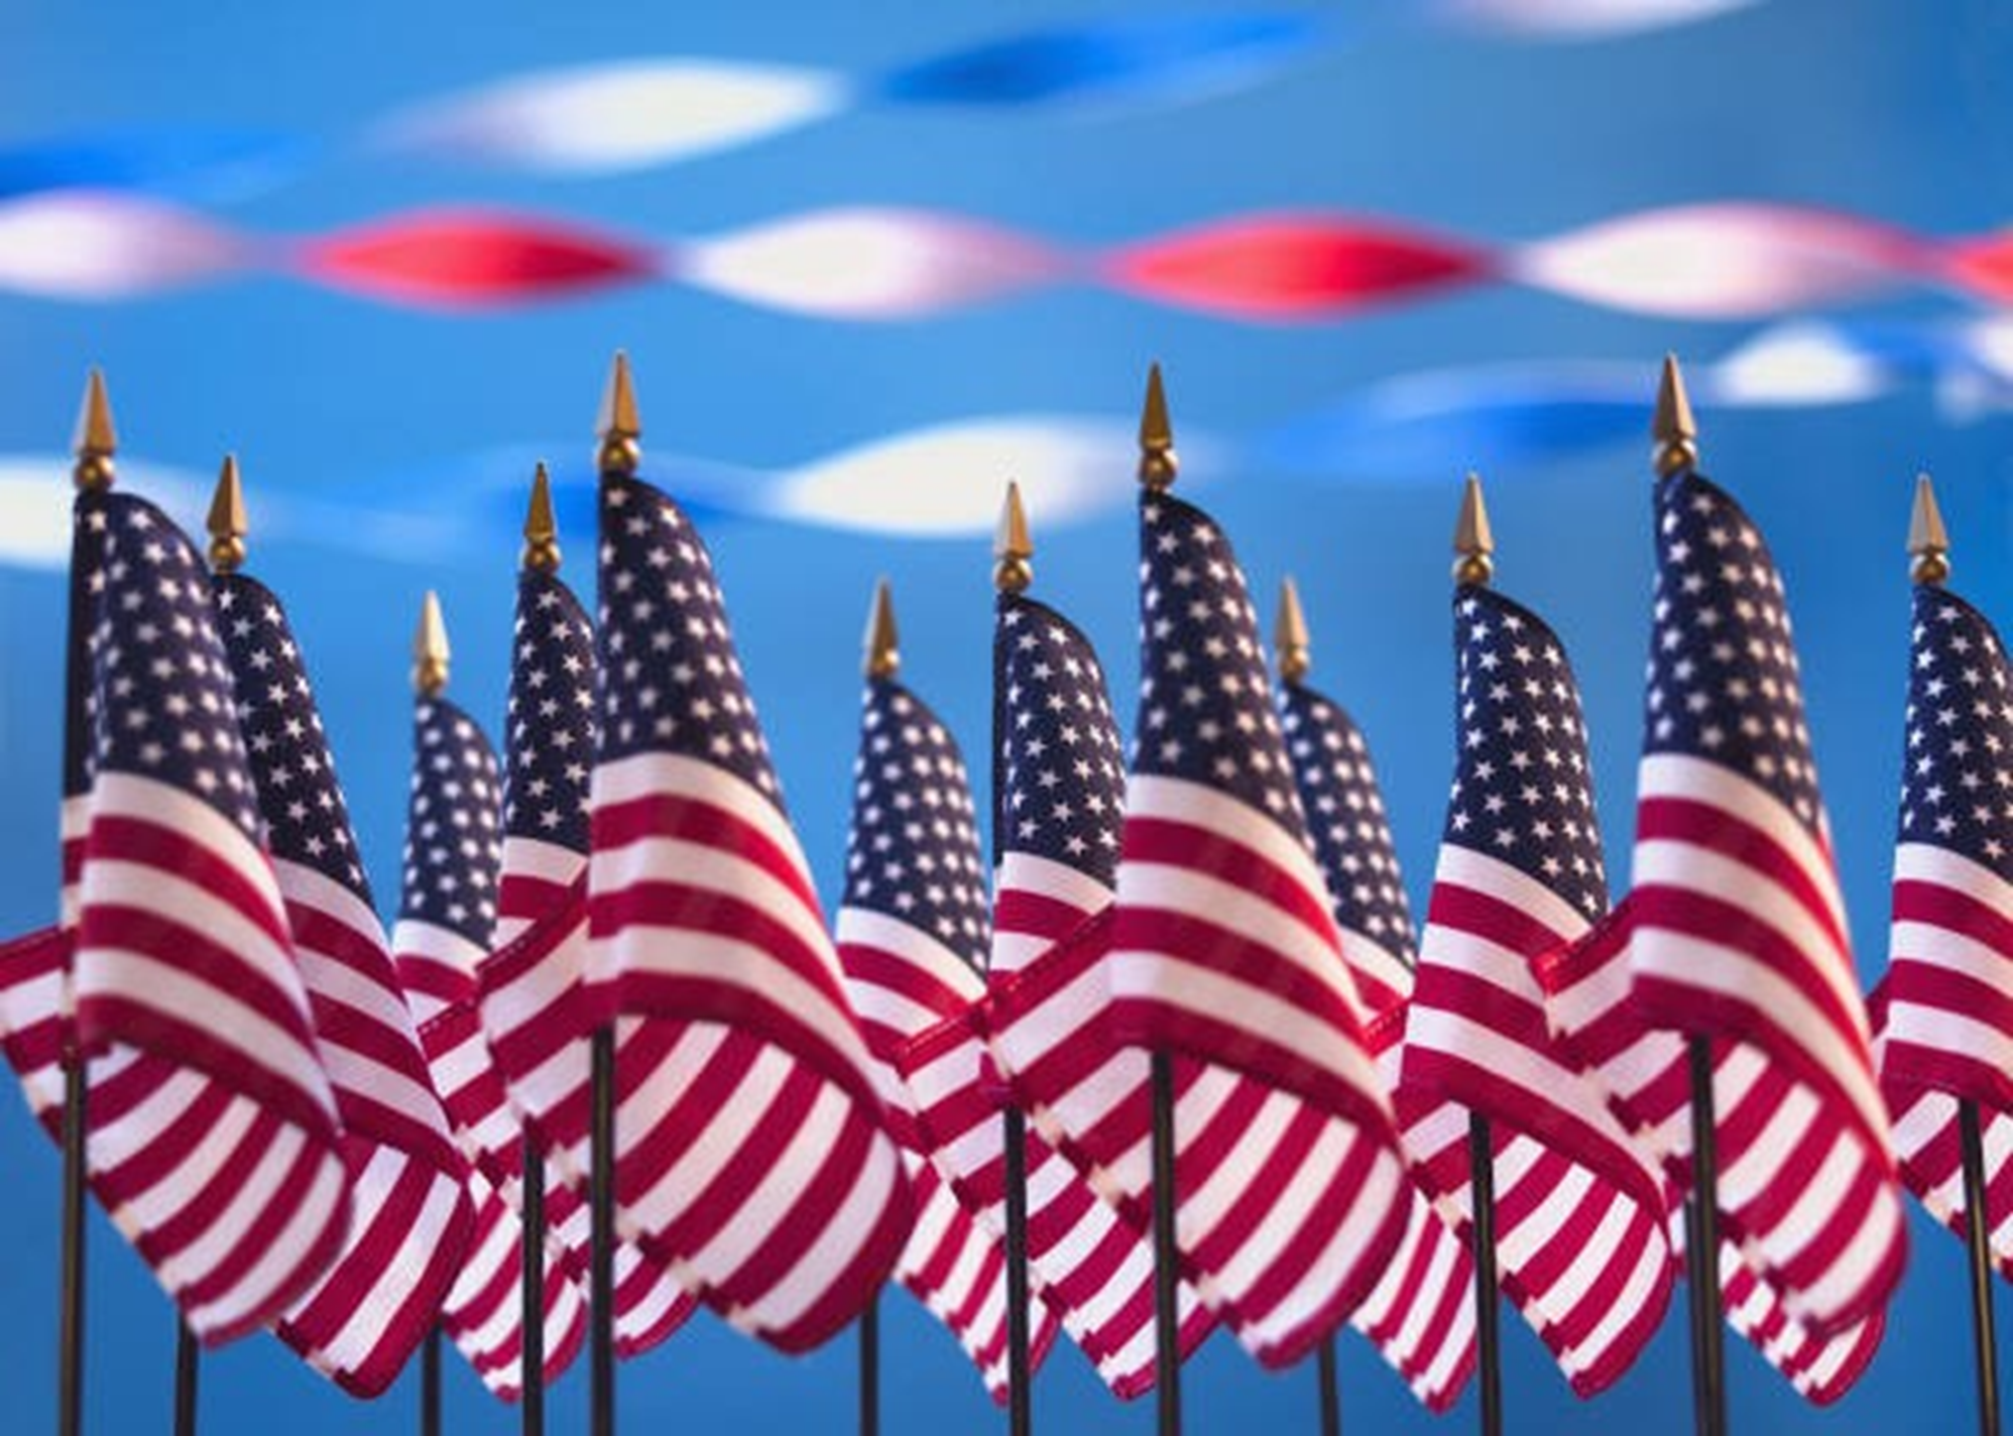
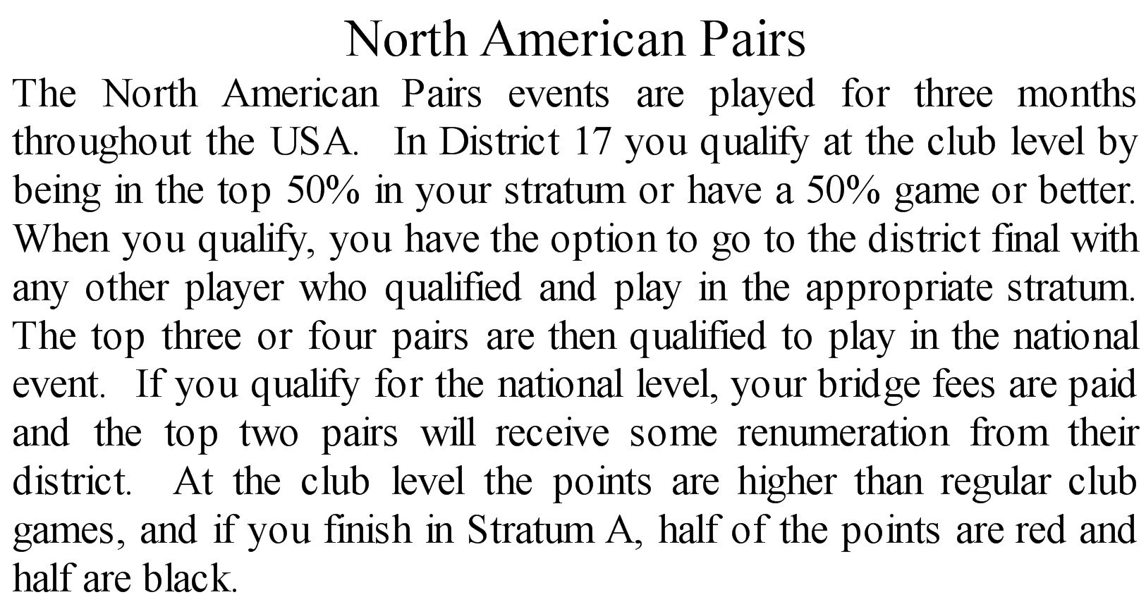

Slide 7
North American Pairs Schedule
North American Pairs Schedule
Sunday, July 14th & 21st – 1:30 PM
Monday, July 15th & 22nd – 12:00 NN
Tuesday, July 16th & 23rd – 12:00 NN
Wednesday, July 17th & 24th 6:00 PM
Friday, July 19th & 26th – 12:00 NN
Saturday, July 20th & 27th – 12:00 NN
Tuesday, July 7th & 21st – 12:00 NN
Wednesday, July 8th & 22nd – 6:00 PM
Friday, July 10th & 24th – 12:00 NN
Saturday, July 11th & 25th – 12:00 NN
Entry fee:
$7.00/person
Entry fee:
$7.00/person
Half Red and Half Black
Masterpoints
Half Red and Half Black
Masterpoints

Slide 8
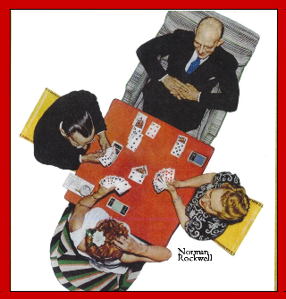
499er Game Every Saturday
PAIRS must AVERAGE between 0 & 499 Masterpoints
Join the fun and improve your knowledge of the game
Intermediate/Novice PAIRS Sectional
Please sign up for the 12 Noon game
Entrants must have between 0 & 300 Masterpoints
with Ellen Eastman
Bring your own partner !
Saturday, January 12, 2019
In addition at
10:30 AM on Saturdays there will be free One-Hour Bridge Lessons before the game
12:00 Noon
Go to elpasobridge.com, then to
Special Events page to view schedule

Slide 9

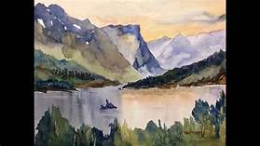


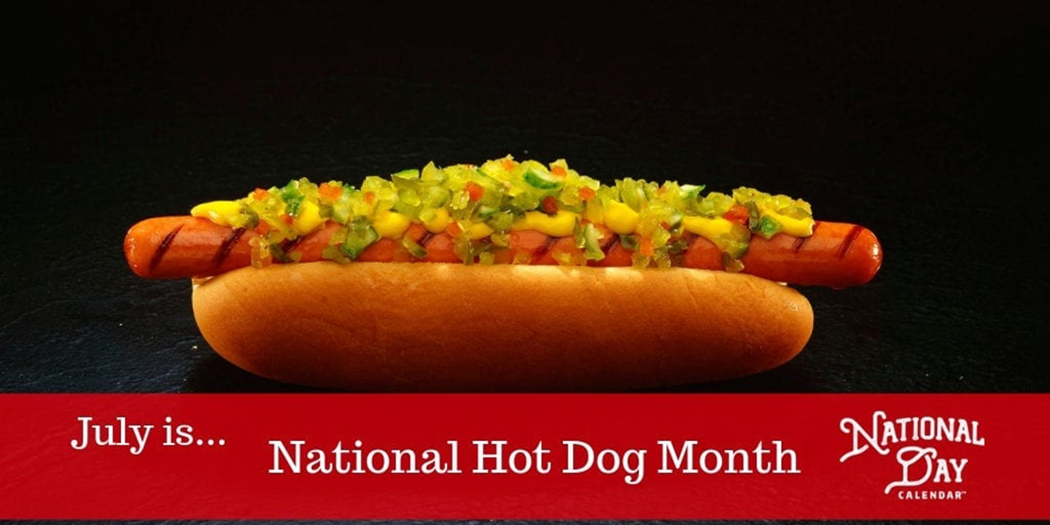

D-Day 75
June 6, 2019
July is National Watercolor Month

Slide 10
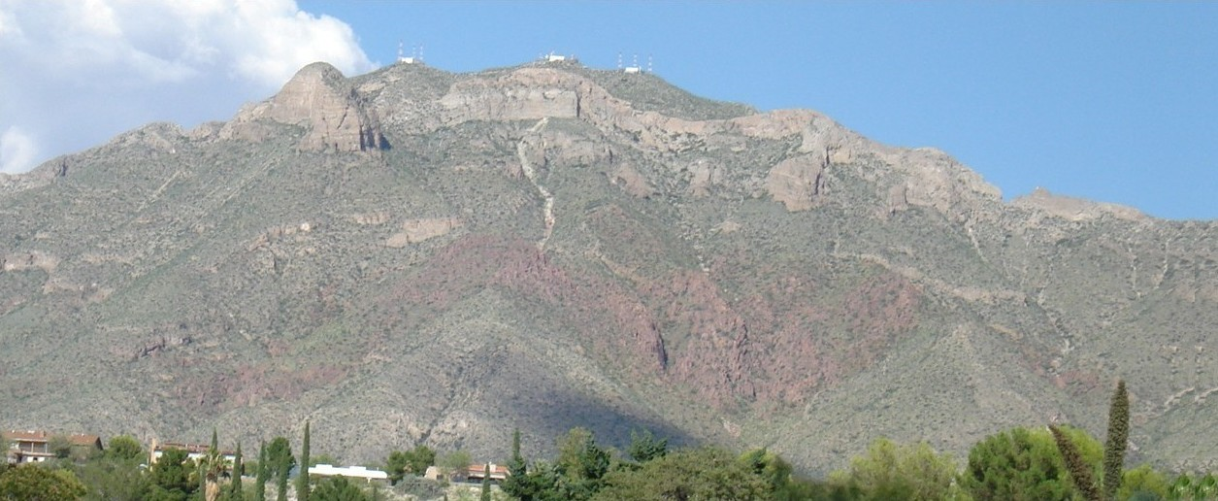

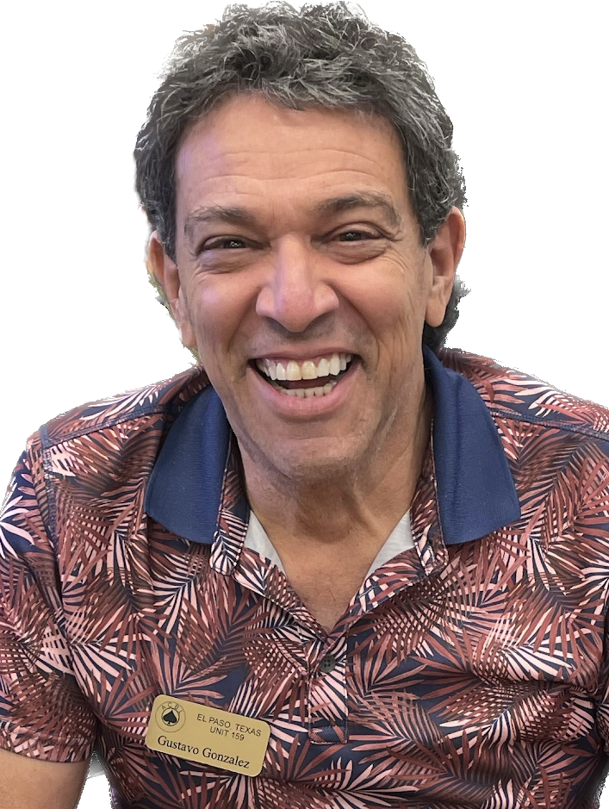
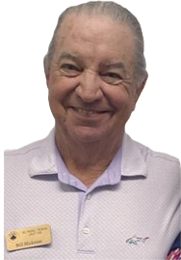
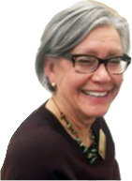
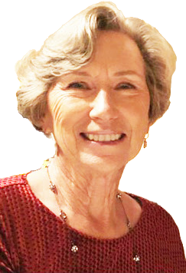
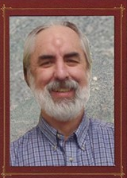
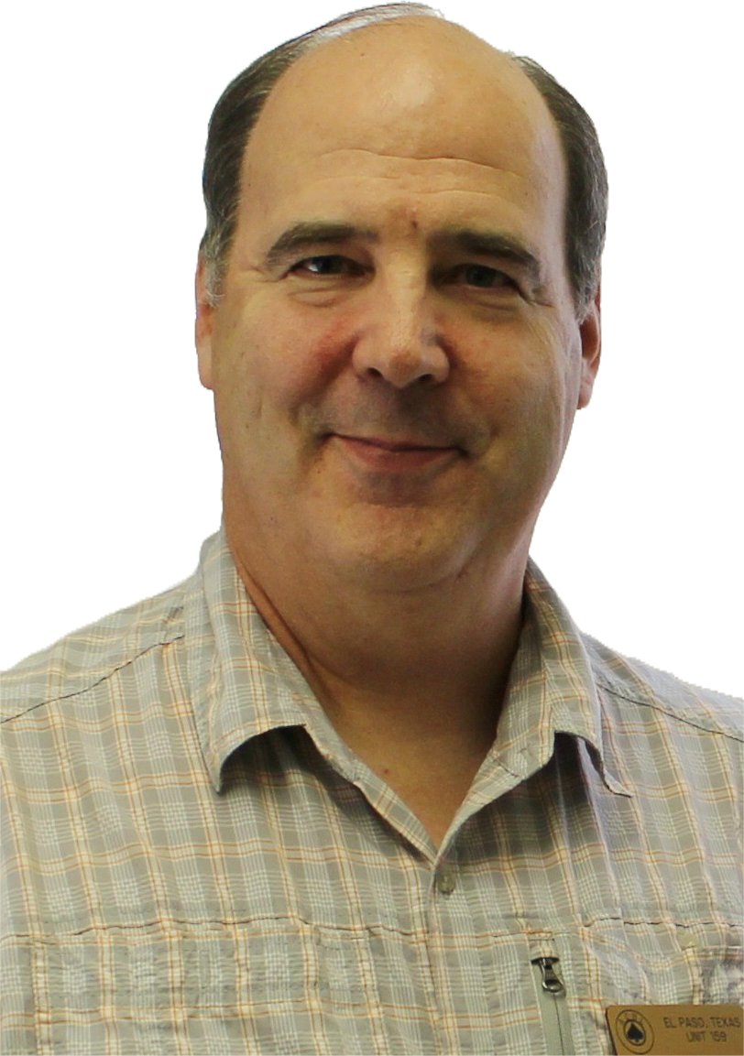
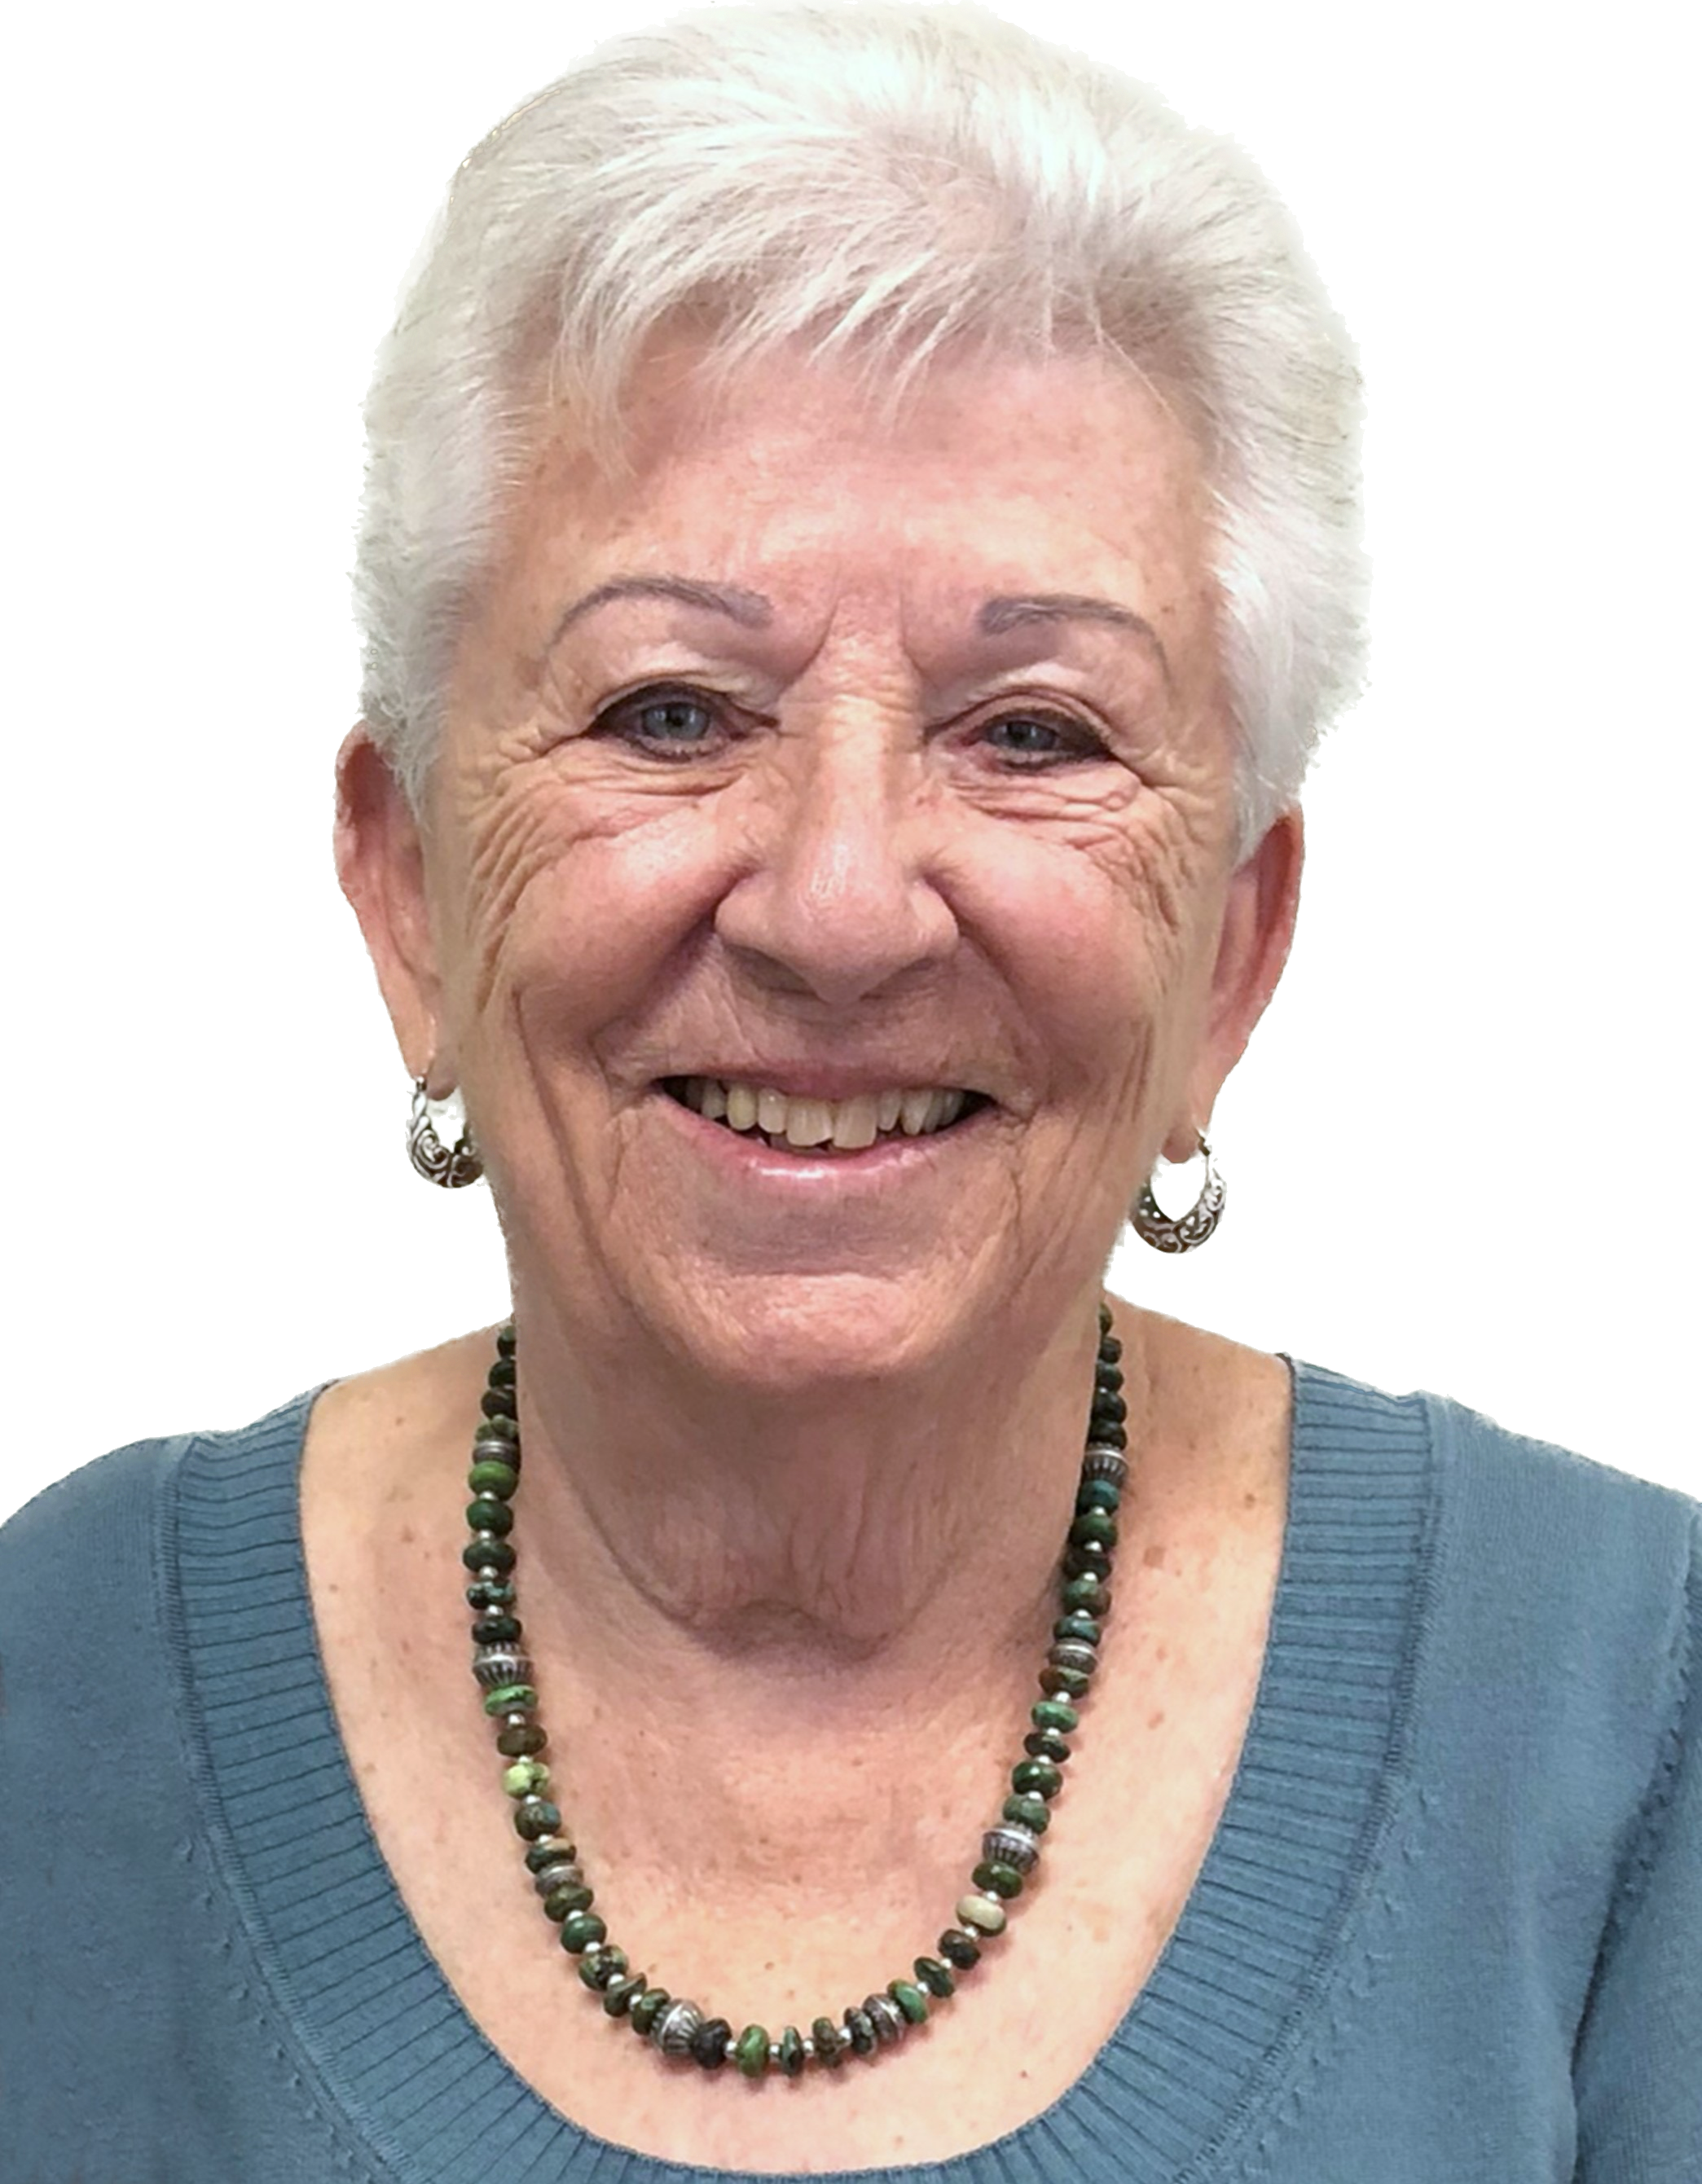
2026 ACBL Unit #159 Board of Directors and other officers
Nancy Stockton, President
Nancy Stockton, President
Nancy Stockton, President
Reggie Feuille, Vice President
Lucy Pfirman
Board Member
Reggie Feuille, Vice President
Reggie Feuille, Vice President
Reggie Feuille, Vice President
Reggie Feuille, Vice President
Reggie Feuille, Vice President
Reggie Feuille, Vice President
Reggie Feuille, Vice President
Ashley Ervin
President
Reggie Feuille, Vice President
Ashley Ervin
President
Ashley Ervin
President
Ashley Ervin
President
Ashley Ervin
President
Ashley Ervin
President
Ashley Ervin
President
Ashley Ervin
President
Ashley Ervin
President
Ashley Ervin
President
Ashley Ervin
President
Ashley Ervin
President
Ashley Ervin
President
Reggie Feuille, Vice President
Ashley Erwin,
Advisor
Reggie Feuille, Vice President
Reggie Feuille, Vice President
Reggie Feuille, Vice President
*Gustavo Gonzalez,
Vice President
*Gustavo Gonzalez,
Vice President
Gustavo Gonzalez,
Vice President
Ashley Erwin,
Advisor
Ashley Erwin,
Advisor
Ashley Erwin,
Advisor
Nancy Stockton,
Advisor
Nancy Stockton,
Advisor
Nancy Stockton,
Advisor
Nancy Stockton,
Advisor
Nancy Stockton,
Advisor
Nancy Stockton,
Advisor
Nancy Stockton,
Advisor
Nancy Stockton,
Advisor
Scott Norris,
Bridge Center Manager
*Barbara Crews,
Treasurer
*Barbara Crews,
Treasurer
*Barbara Crews,
Treasurer
Gustavo Gonzalez, President
Bill Hickman
Vice President/Treasurer
Renee O’Donnell
Secretary
*Barbara Crews,
Treasurer
Nancy Stockton, President
Nancy Stockton,
Nancy Stockton,
Nancy Stockton,
Nancy Stockton,
President
President
President
President
Vice President
Vice President
Vice President
*Newly Elected/Appointed Board Members
Vice President
*Newly Elected/Appointed Board Members
*Newly Elected/Appointed Board Members
*Newly Elected/Appointed Board Members
*Newly elected board members
*Newly elected board members
*Newly elected board members
*Newly elected board members
*Newly elected board members
*Newly elected board members
*Newly elected board members
*Newly elected board members
*Newly elected board members
*Scott Norris,
Bridge Center Manager
*Phil Anderson
Unit Accountant
* Non-Board Member

Slide 11
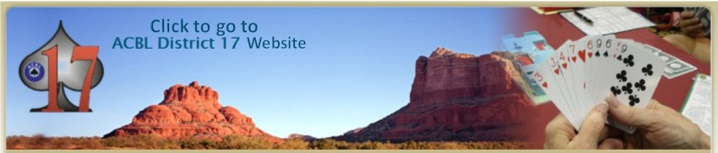

Visit the Unit 159 and ACBL Connections page on our website for one-click access to:
Distr
District 17 Webpage
Bridge Buzz
Standings on:
Mini-McKinney
Ace of Clubs
District Races
National Races

Slide 12

July 21, 2025

Slide 13
North American Pairs Schedule
North American Pairs Schedule
Sunday, July 14th & 21st – 1:30 PM
Monday, July 15th & 22nd – 12:00 NN
Tuesday, July 16th & 23rd – 12:00 NN
Wednesday, July 17th & 24th 6:00 PM
Friday, July 19th & 26th – 12:00 NN
Saturday, July 20th & 27th – 12:00 NN
Tuesday, August 4th & 18th – 12:00 NN
Wednesday, August 5th & 19th – 6:00 PM
Friday, August 7th & 21st – 12:00 NN
Saturday, August 8th & 22nd – 12:00 NN
Entry fee:
$7.00/person
Entry fee:
$7.00/person
Half Red and Half Black
Masterpoints
Half Red and Half Black
Masterpoints

Slide 14
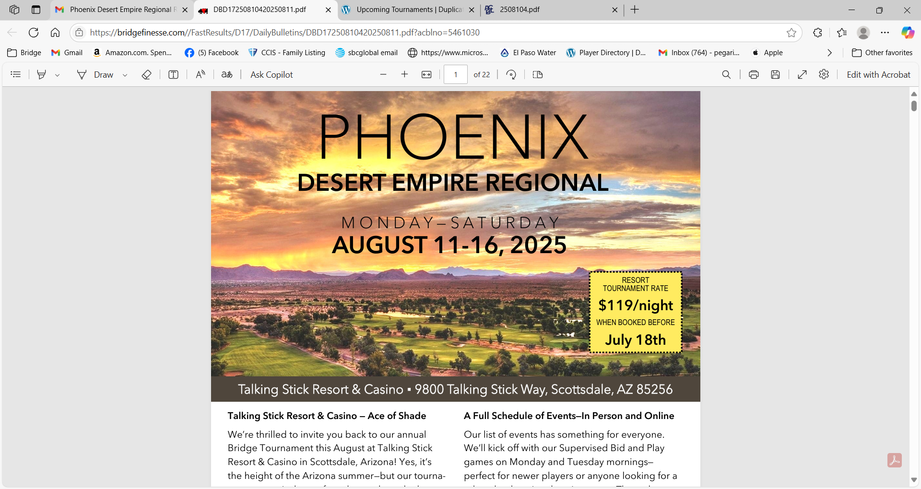
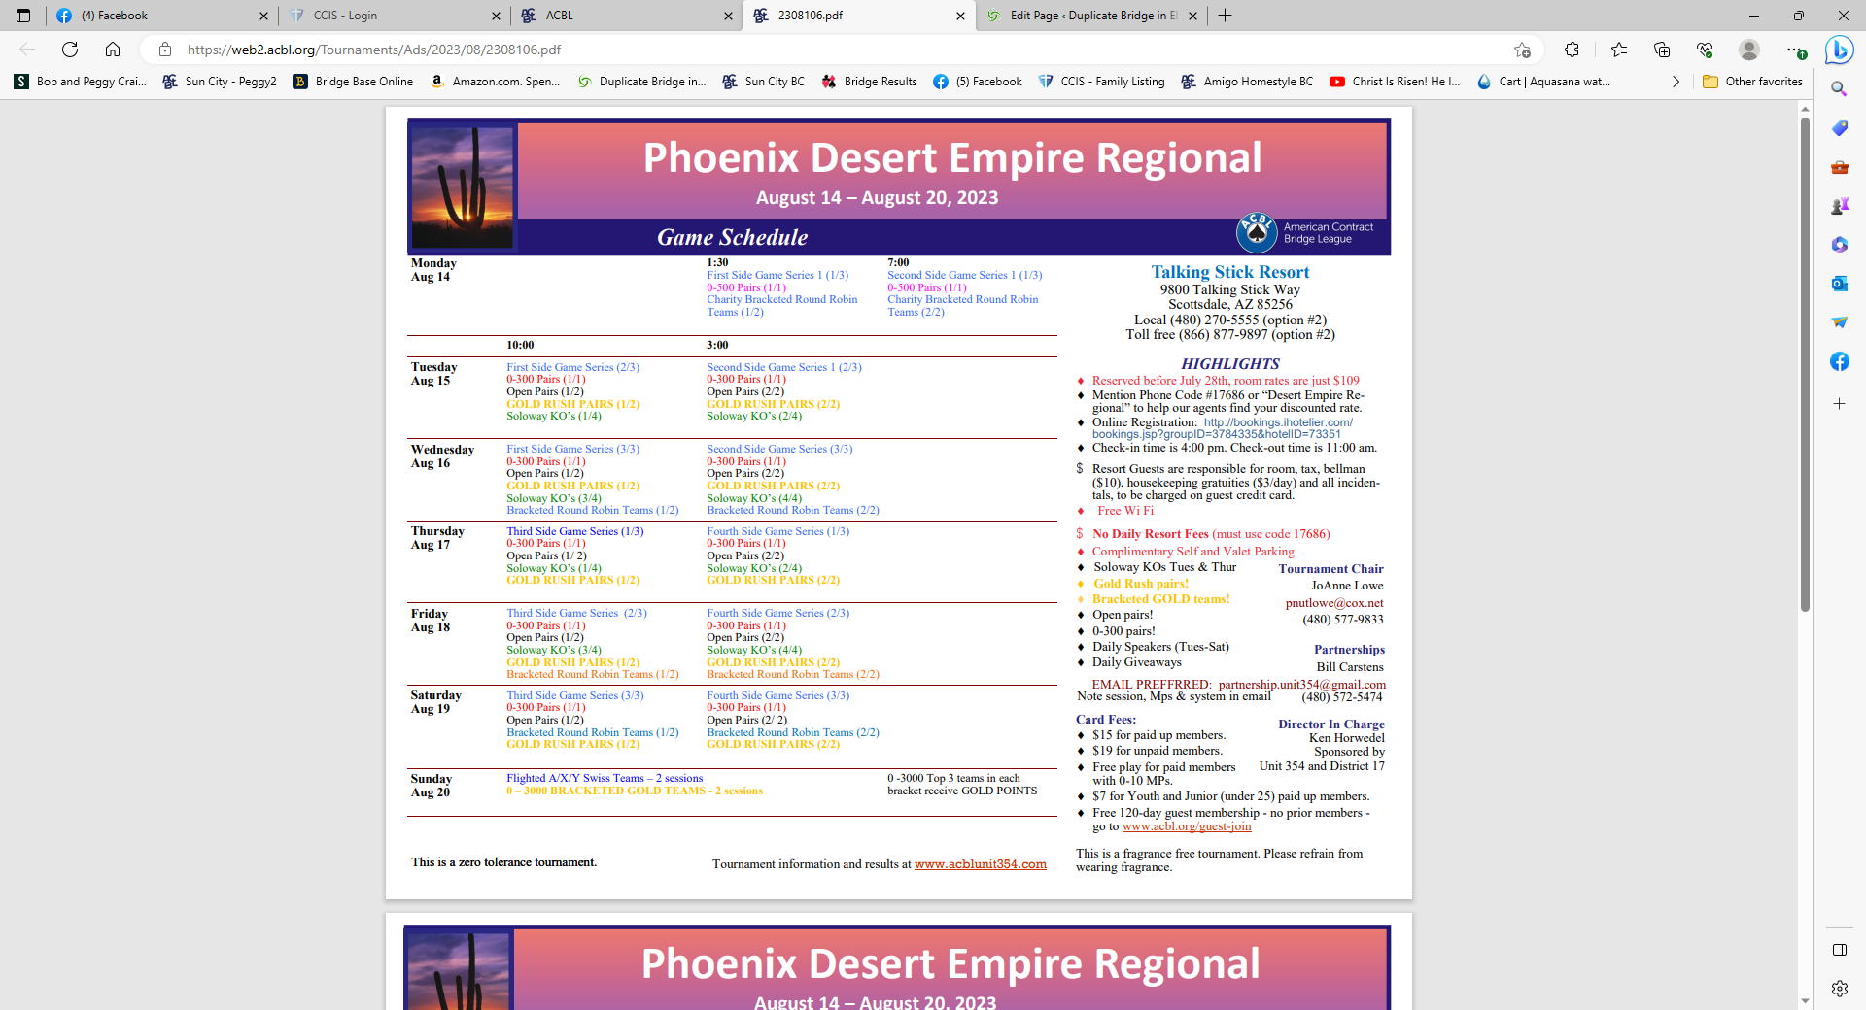
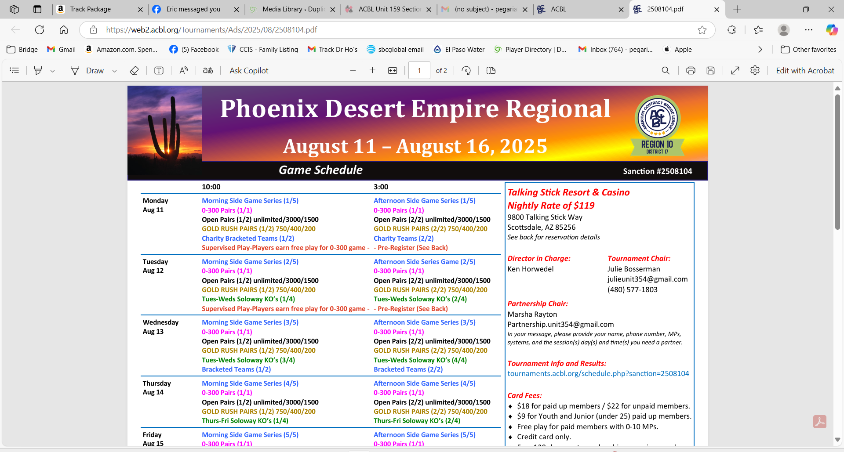
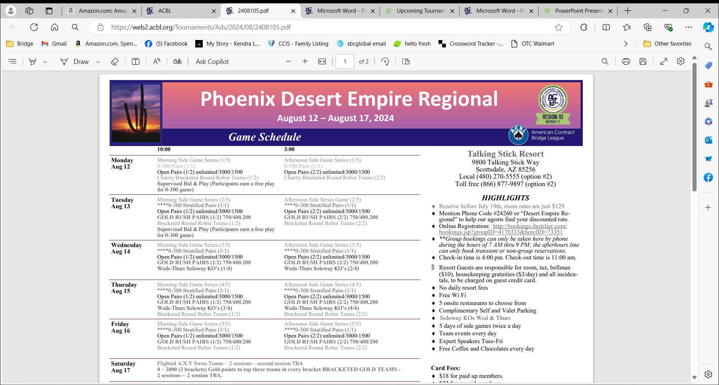
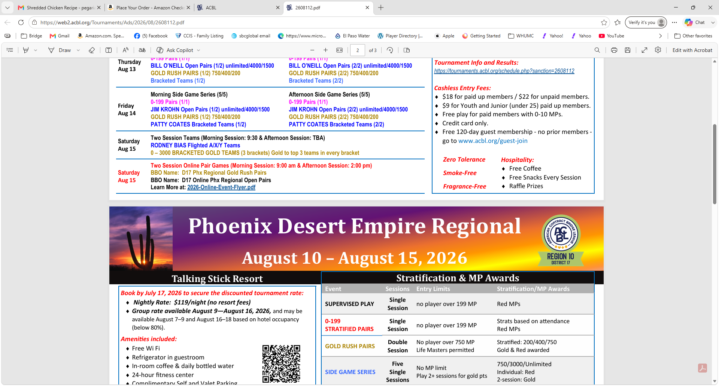
Talking Stick Resort
Talking Stick Resort
9800 Talking Stick Way, Scottsdale, AZ 85256
Nightly Rate of $119.00
Local (480) 270-5555 (Option #2), Toll free (866) 877-9897
9800 Talking Stick Way, Scottsdale, AZ 85256
Local (480) 270-5555 (Option #2), Toll free (866) 877-9897 (Option #2)
Talking Stick Resort & Casino
9800 Talking Stick Way
Scottsdale, AZ 85256

Slide 15
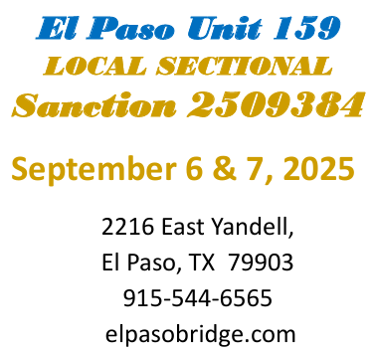

Suspended

