Slide 1
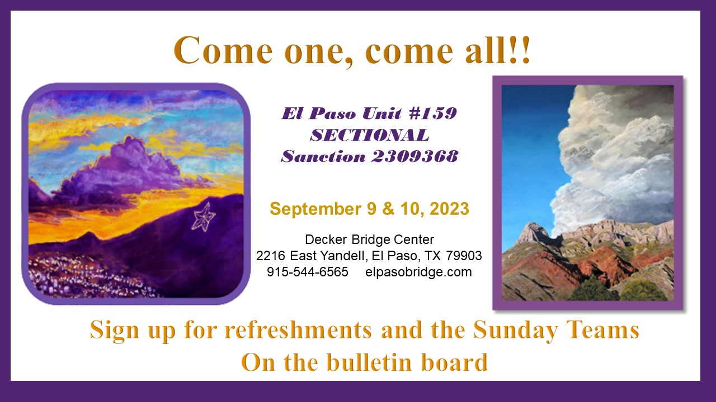
Congratulations to
the Annual El Paso
September 2023
tournament winners

Slide 2
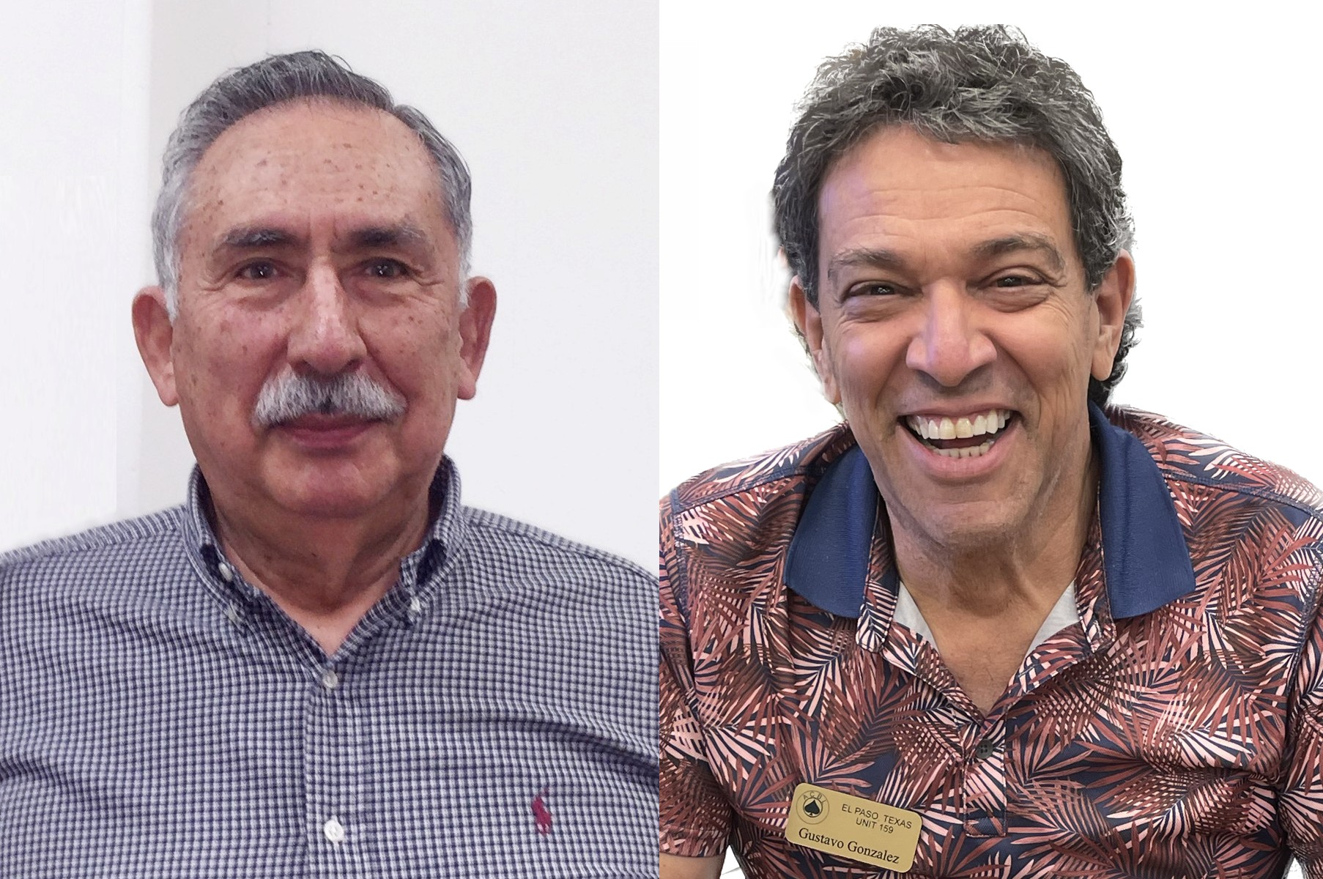

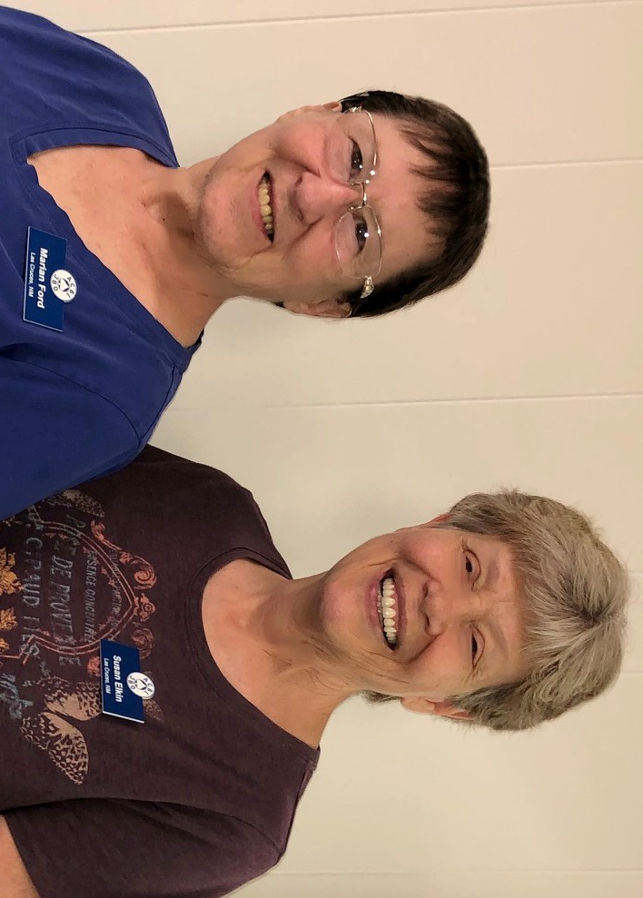
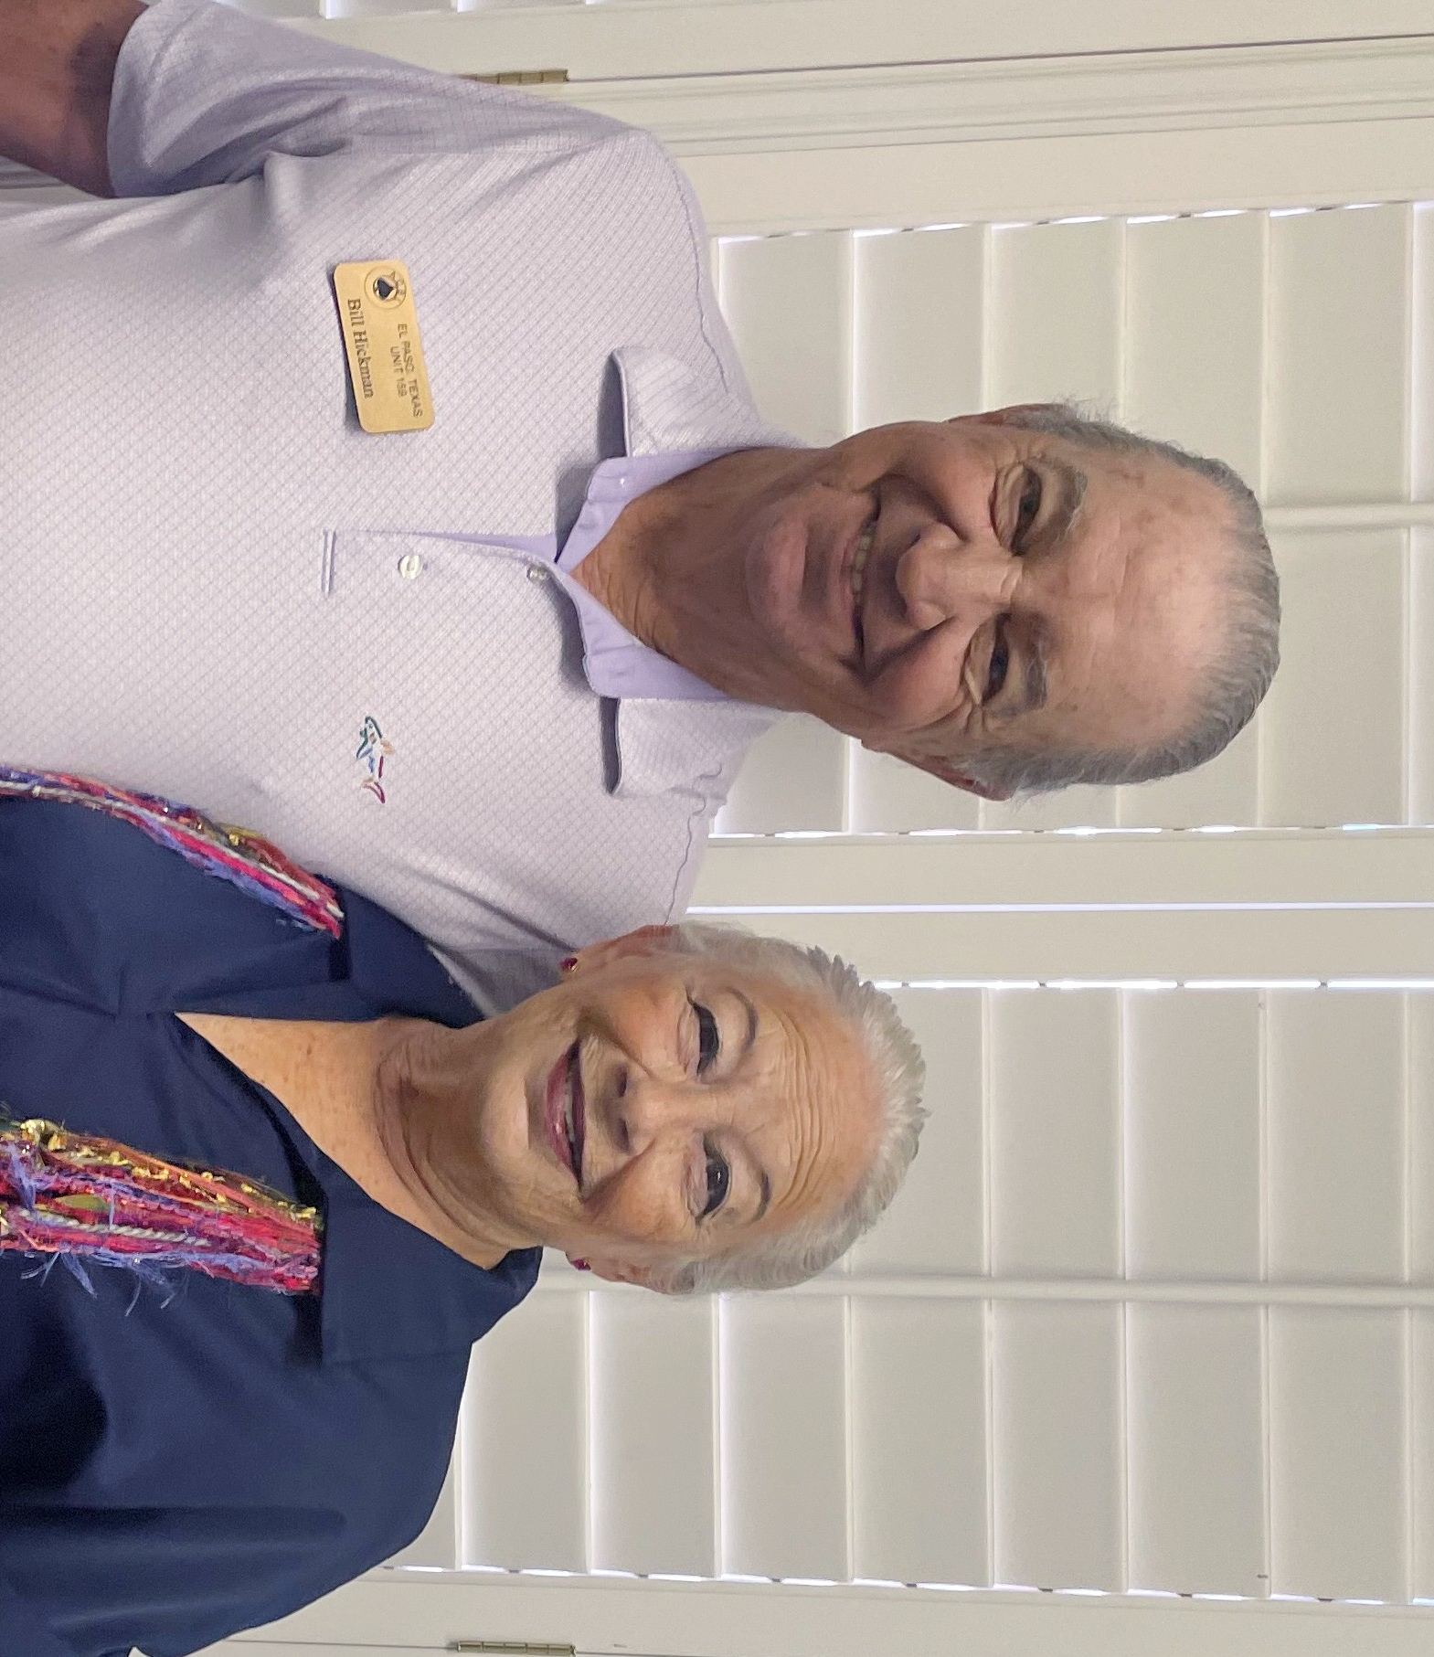
Saturday AM
Stratified Pairs
Flights A & B
Barbara Crews & Lorraine O’Donnell
Flight C
Edgar Flores & Gustavo Gonzalez
Saturday AM
499er’s Pairs
Flights A & B
Marian Ford & Susan Elkin
Flight C – Bill Hickman & Nancy Welshimer

Slide 3
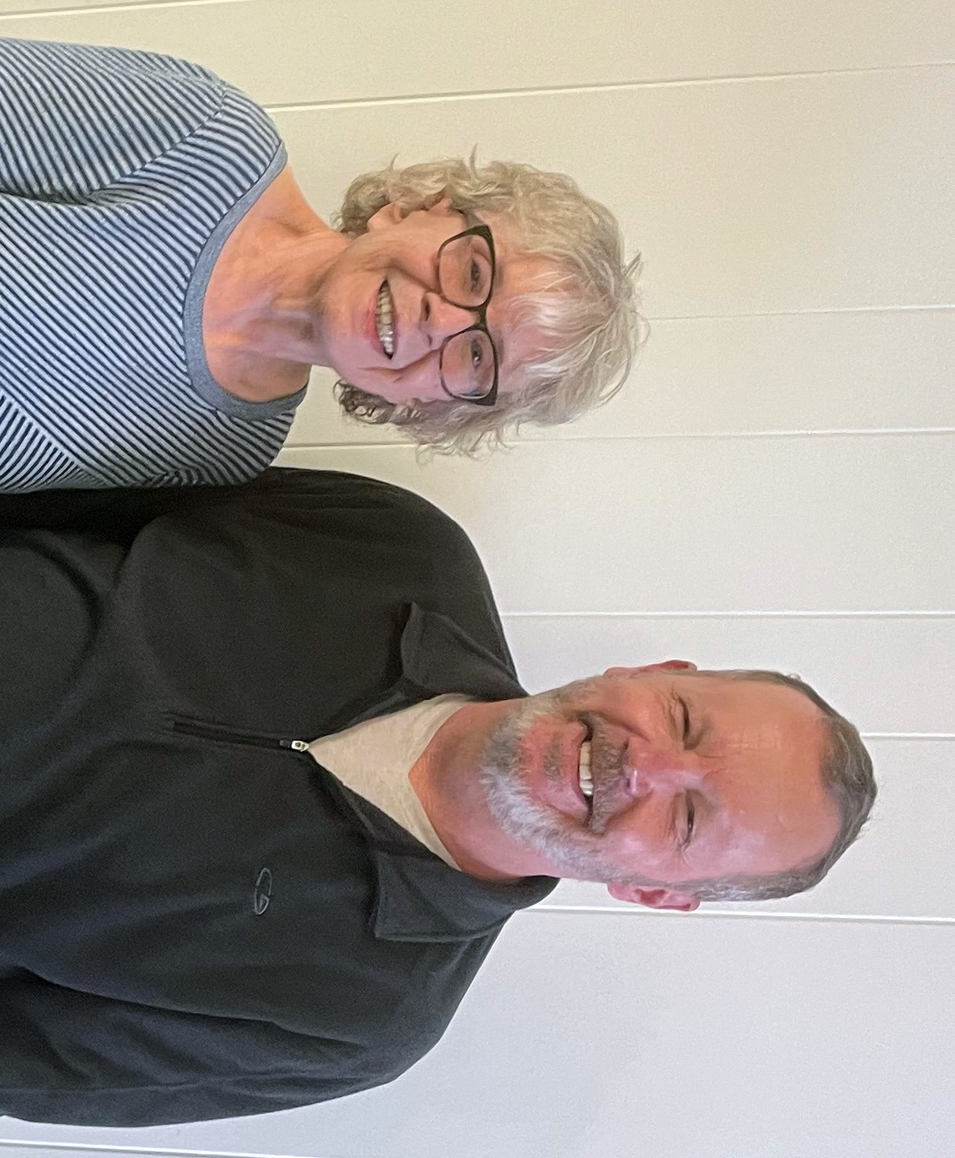
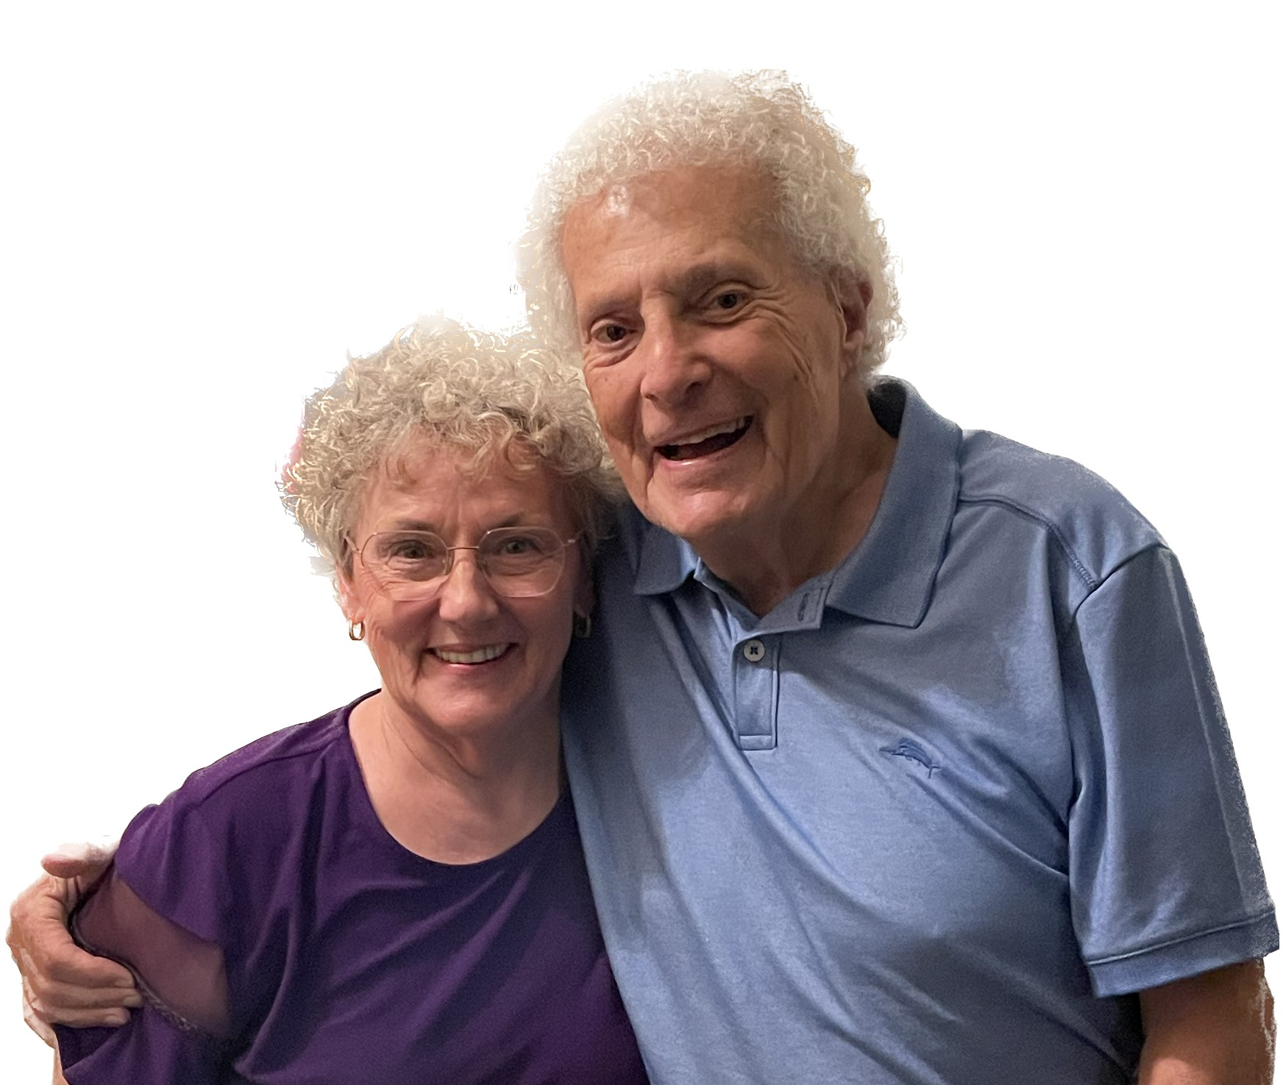
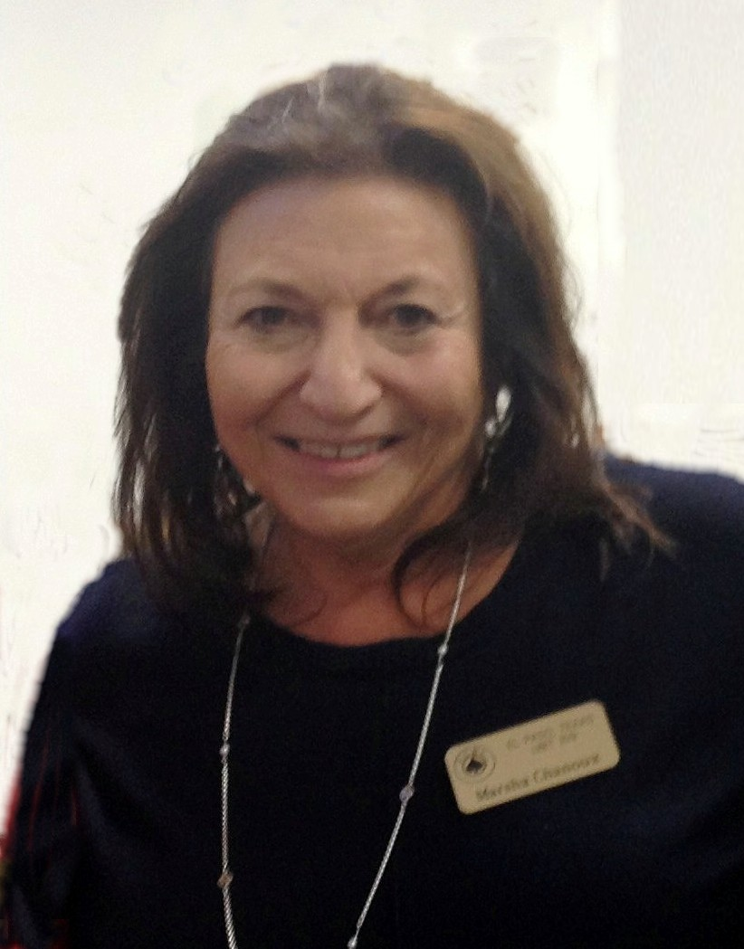
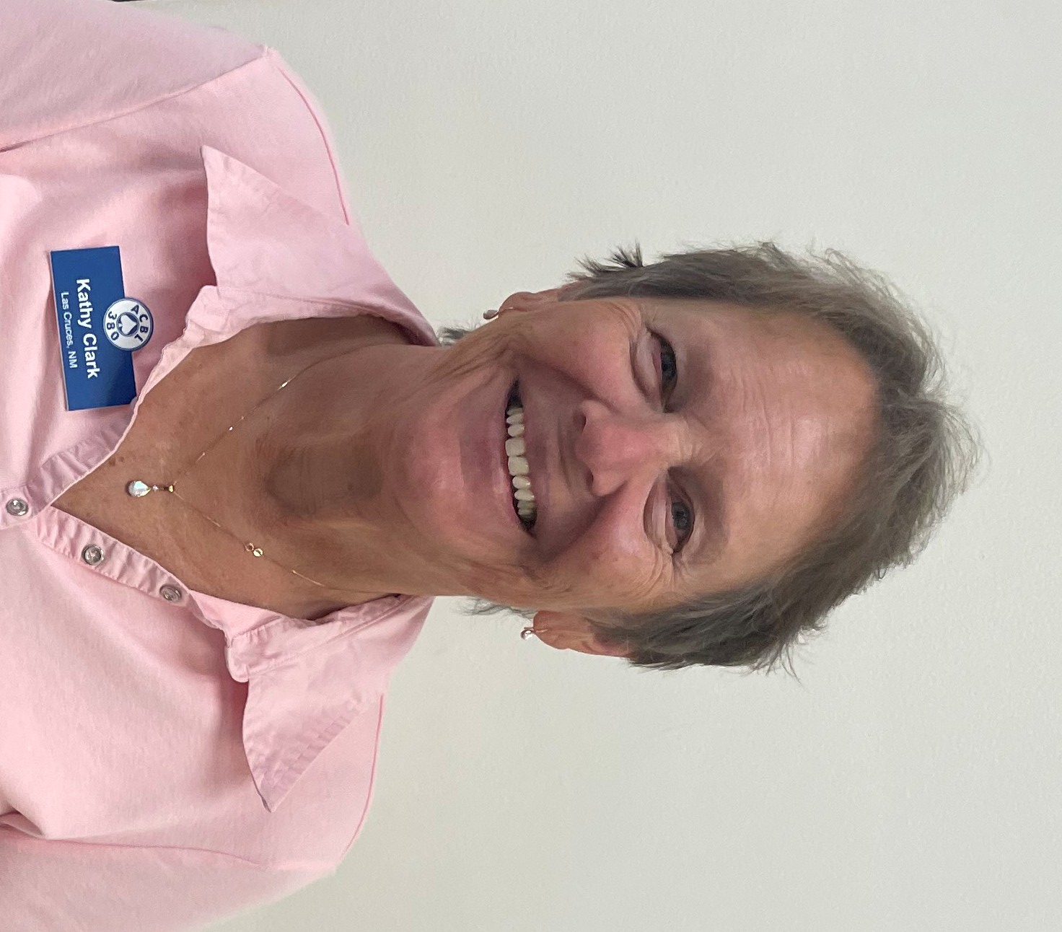
Saturday PM
Stratified
Pairs
Flight A tied for 1st & 2nd – Ellen Eastman, Paul Ritters, Peggy Craig, Jerry Ruther
Flights B & C Ellen and Paul
Saturday PM 499er’s Pairs
Flight A – Val Brown & Kay White
Flight B – Marion Ford & Susan Elkin
Flight C – Marsha Chanoux & Kathy Clark

Slide 4
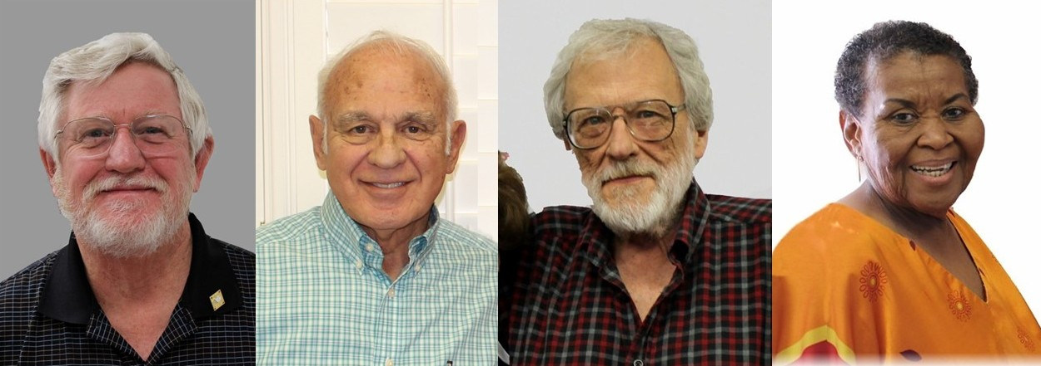
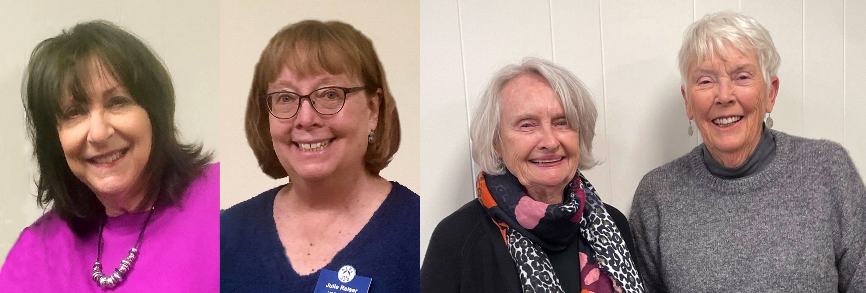
Sunday Swiss Teams
Flight A - Steve Nordberg, Ralph Liguori,
Chuck Duke, Barbara Harrid
Flight B - CJ Tompkins, Jay Woods
Ashok Bhakta, Steve Kubala
Flight C - Nancy Stockton, Julie Reiser
Meg O’Leary, Sheila Unglaub

Slide 6
A big THANK YOU to ALL the players who supported our September Sectional. We had a good turnout from our club members at all levels of play.
Thanks to all the volunteers who made it possible, and especially to Bob Craig, who agreed to direct our Sectional tournament in order to support our club!
Bob’s efforts and our overall good attendance gave us a much-needed boost to our financial results for the year.
And again, thank you to the tournament volunteers (Lorena, Joan, Scott, Bill) and our tournament sponsors (Billy & Barb Crews and Tom & Dixie Wicker) for their part in making it a success!
Nancy Stockton, Unit #159 President

